Slide 1



CONSULTARE INC. GROUP
A Compliance Co.
Specializes in regulatory, accreditation, certification, quality management system software, and IT solution consultancy
Established 2013

Slide 2
Service Logs
Proof or manifestations of your activities on a certain task or tasks whether daily, weekly or monthly basis.
PURPOSE:
Serves as your output to support your log in/log out (Timekeeping)
Use as attachment for Client’s Service Invoice
To itemize billable tasks per Account.
Maintains Consultare and Client relationship

Slide 3
Billable and Non-Billable Tasks
Billable Tasks:
Tasks, services and documents done for the client
Working on a client's projects, communicating with them, and revising your work for them could all be considered billable activities.
Non-Billable Tasks:
Activities such as Internal Trainings, Internal Meetings, VO Discussions, updating
Internal Templates, or Monitoring Sheets, and other Admin Tasks.
Account is usually under CIG or any Consultare Department

Slide 4
Different Ways to Record Service Logs
Can be done manually:
Direct way of recording your daily output/activity.
Can be done using the Mypro/Gantt Chart:
A graphical representation of project progression
Helps the team to plan work around deadlines and properly allocate manpower.

Slide 5

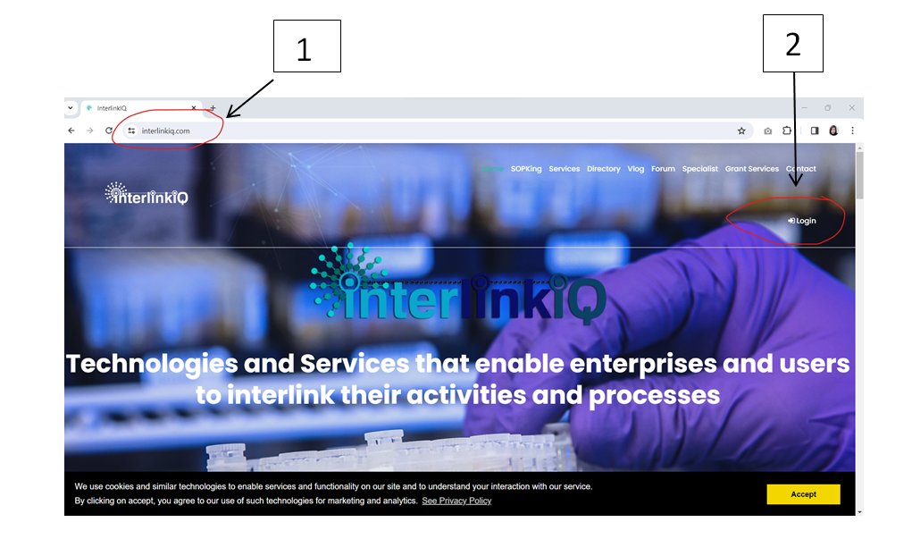
Where To Record Your Service Logs?
Step-by-step navigation:
1. Type in interlinkiq.com in your
web browser.
2. Click the Login

Slide 6
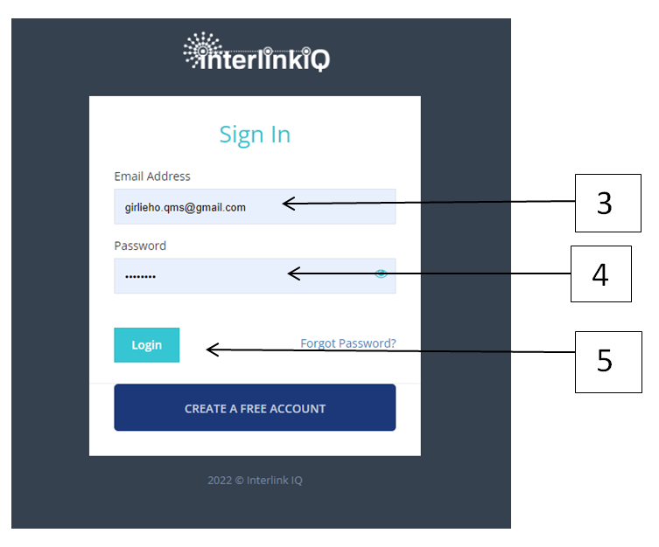
Where To Record Your Service Logs?
Step-by-step navigation:
3. Type in your company email address
4. Type in your password
5. Click the Login

Slide 7
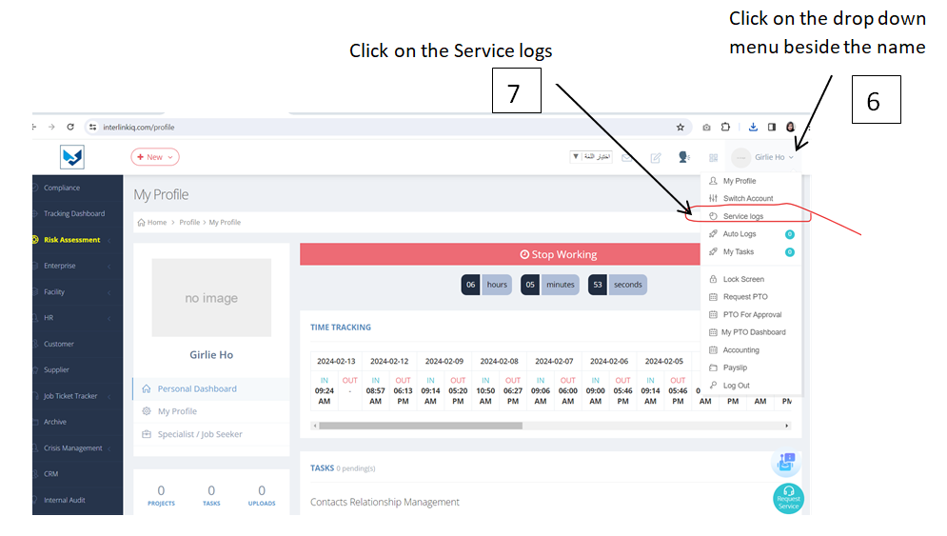
Where To Record Your Service Logs?
Step-by-step navigation:

Slide 8
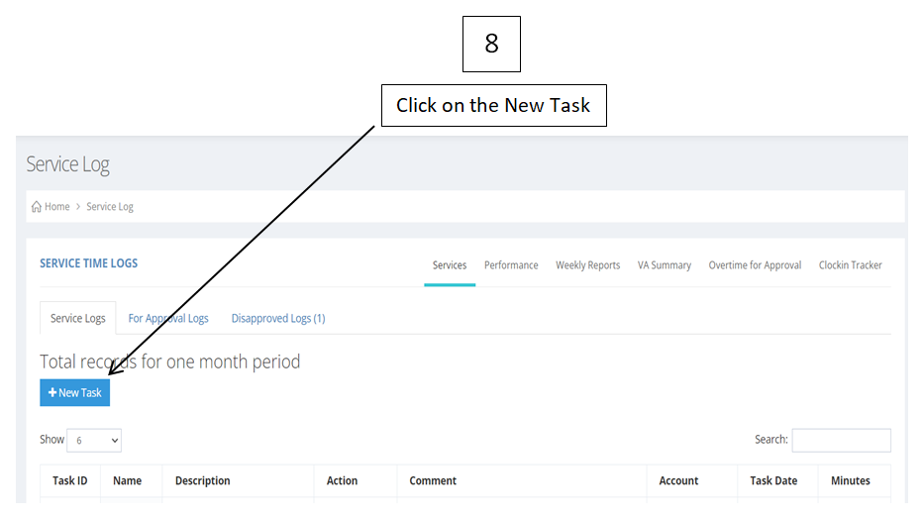
Where To Record Your Service Logs?
Step-by-step navigation:

Slide 9
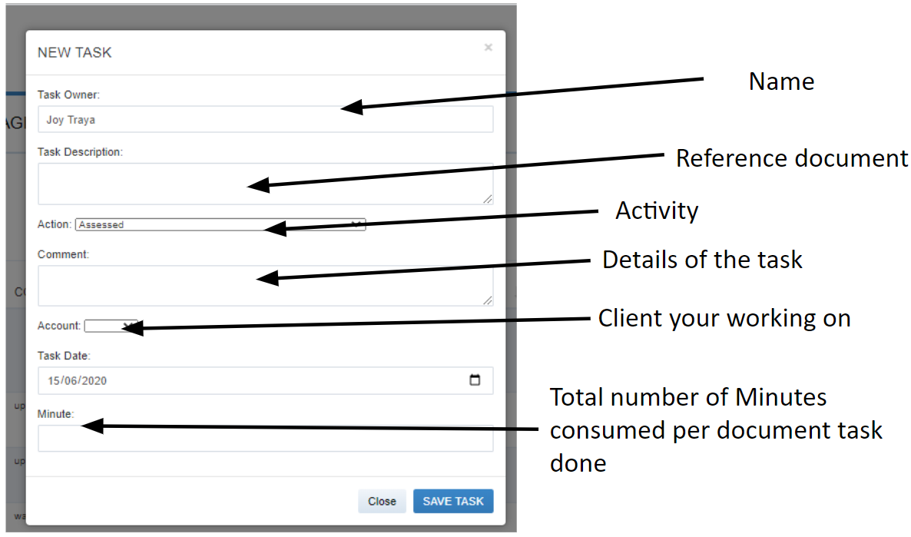
Manual Service Log

Slide 10
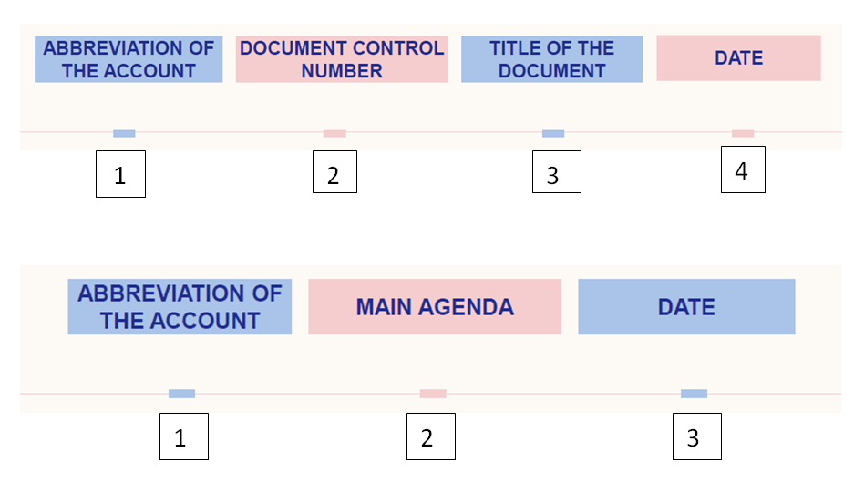
Standard Task Description
For both Billable and Non-Billable Tasks

Slide 11
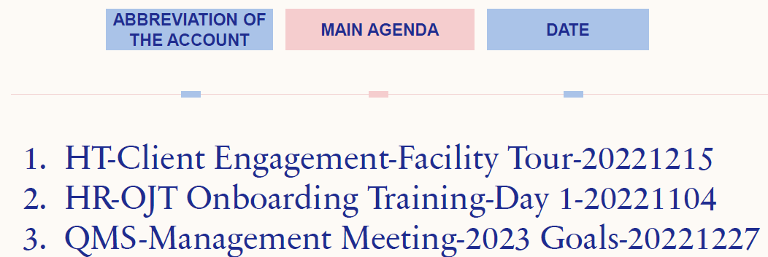
Standard Task Description
Standard Task Description for Discussions

Slide 12
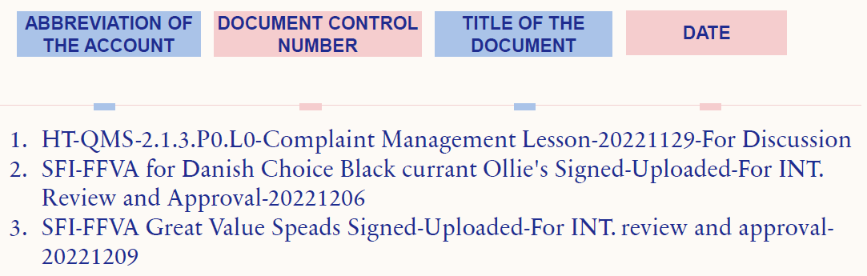
Standard Task Description
Standard Task Description for Document

Slide 13
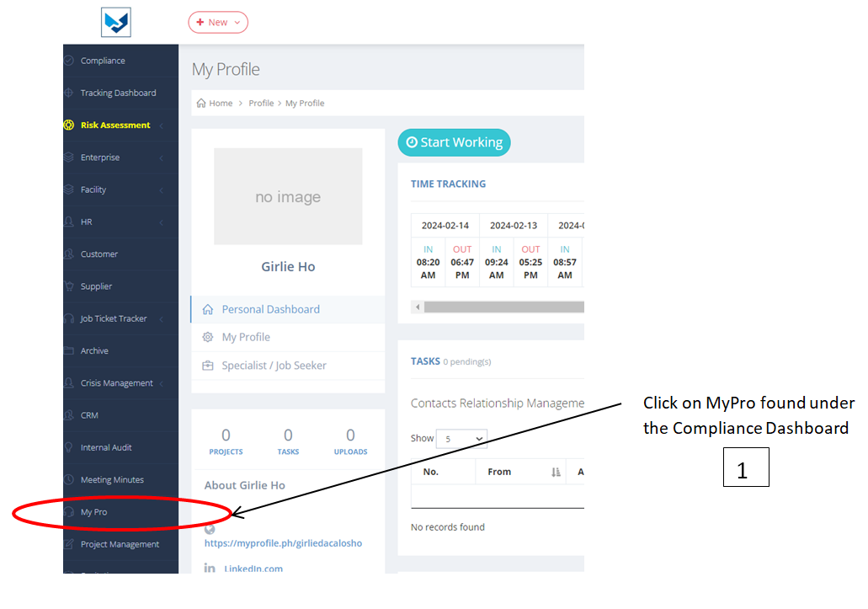
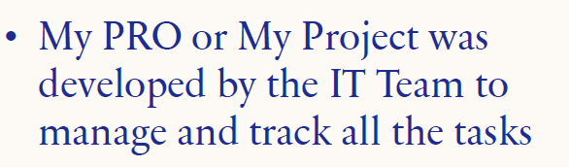
Where to Record Service Log in My Pro

Slide 14
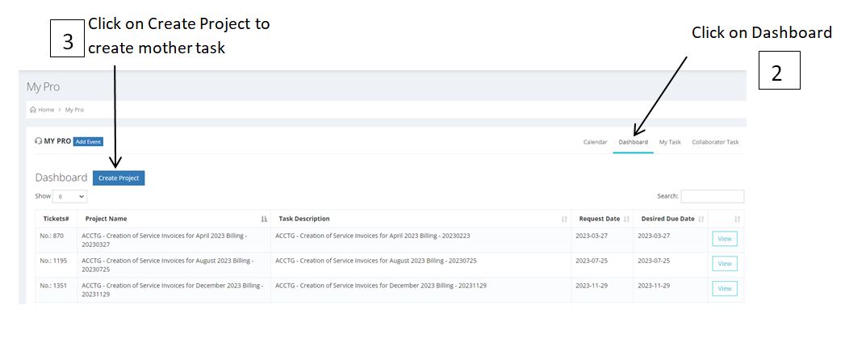
Where to Record Service Log in My Pro

Slide 15
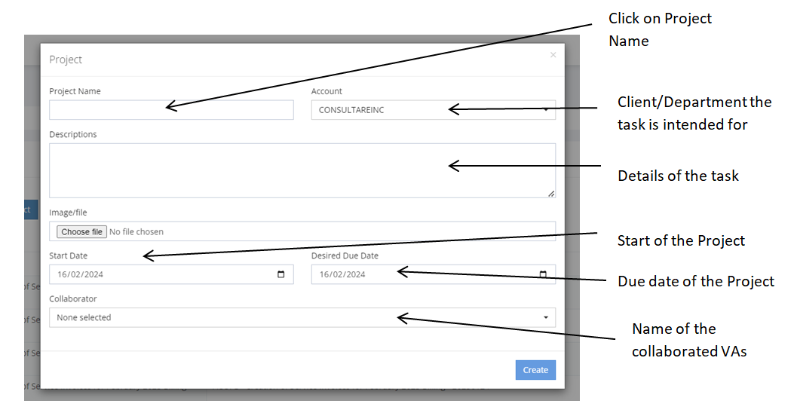
Where to Record Service Log in My Pro

Slide 16
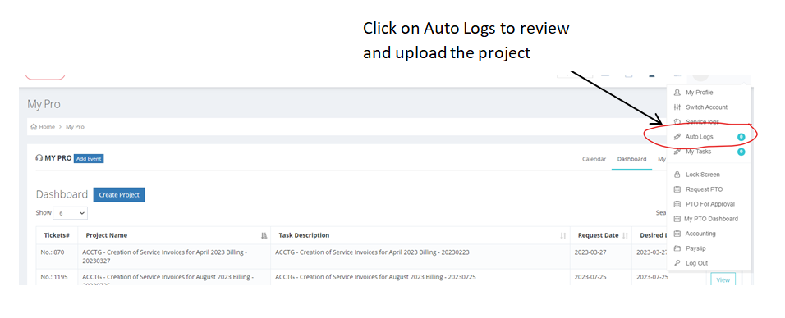
Where to Record Service Log in My Pro

Slide 17
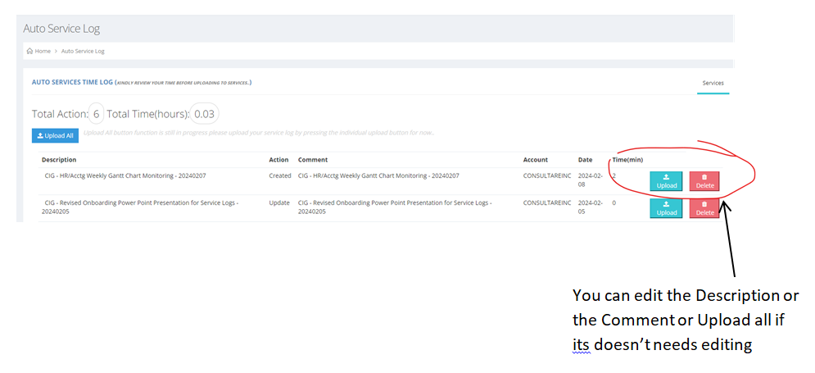
Where to Record Service Log in My Pro

Slide 18
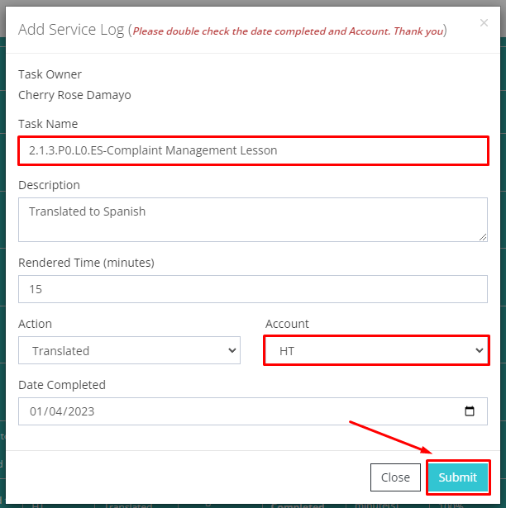
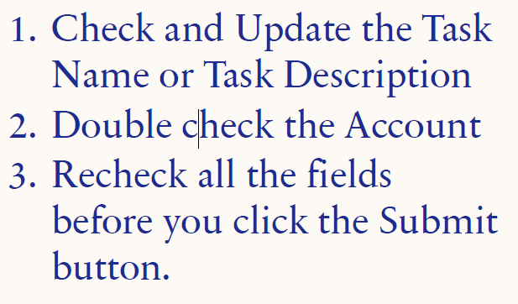
Where to Record Service Log in My Pro

Slide 19
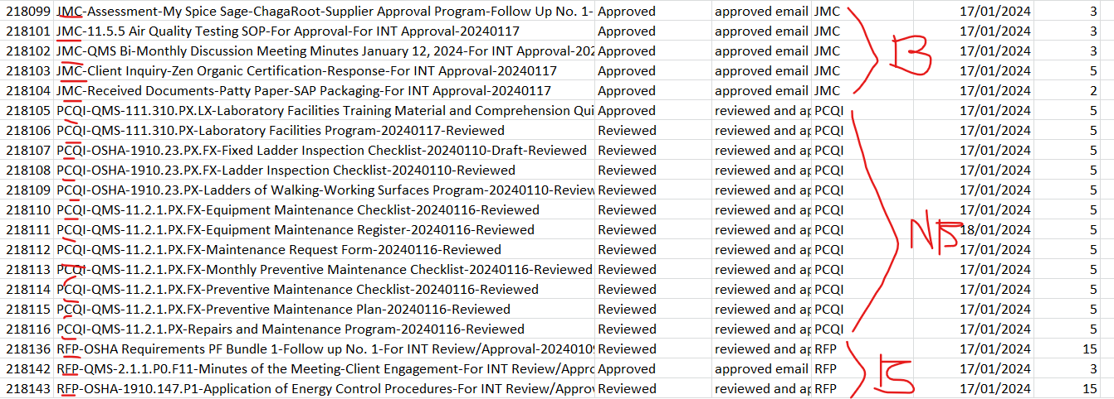
Sample Billable & Non-Billable Task

Slide 20
Things to Remember:
All Virtual Assistant must update their Service Logs daily.
Virtual Assistant’s salaries will be put on hold for those with incomplete service logs within the cut off.
All Service Logs must be breakdown properly according to standard task description.

